Slide 1

Shark Tank Companies
Ryan Coslove (rmc326)

Slide 2

Shark Tank Companies
Source: https://www.kaggle.com/yamqwe/shark-tank-companiese?select=Shark+Tank+Companies.csv
Consisting of attributes such as:
Deal
Description
Asked for
Valuation
Exchange for Stake

Slide 3
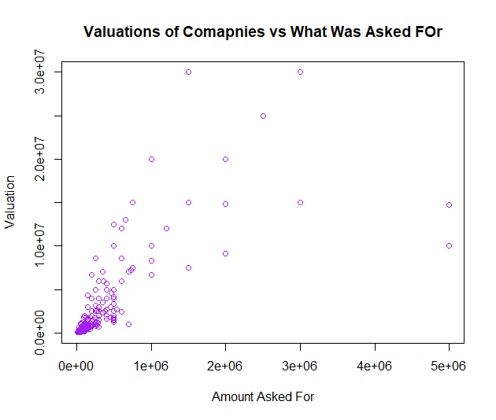
Company Valuations vs What Was Asked For
The Valuation of the companies were often within the thousands to hundred thousands.
The asking price was usually proportional the company’s valuation.
The points on the far right asked for a large amount but was disproportionally valuated lower than others.

Slide 4
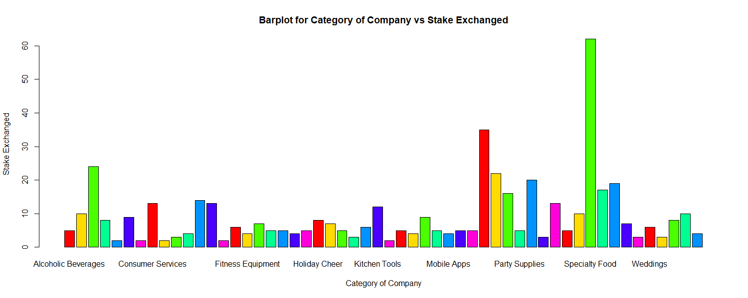
Barplot for Category of Company vs Stake Exchanged
The category of Specialty Food has the highest amount of stake exchanged vs other categories, on average
Not all categories are visible on the x-axis of the chart, but the lowest exchange rate on average for a category was Baby Apparel

Slide 5
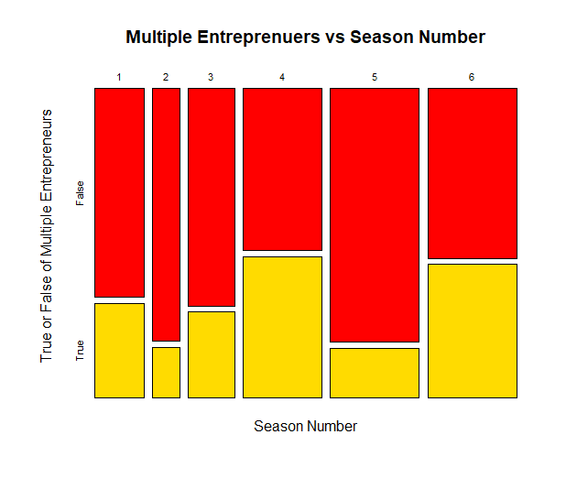
Are there Multiple Entrepreneurs in a Company vs Season Number
Season 4 had the most common occurrences of a company having multiple entrepreneurs compared to other seasons
Season 5 had the lowest frequency of number of companies with multiple entrepreneurs
Season 2 had the least overall in number of companies with multiple entrepreneurs

Slide 6
Application and Implementation
Using these Shark Tank statistics, we can construct predictive models of which companies tend to get the best valuations and overall deals with the Sharks on the show. Anyone who is looking to receive investments in their company can utilize this data to see which categories net the largest profit in their company while offering their optimized level of stake exchanged.

